Slide 1







Interfaces, Models, and Monitoring for Resource-aware Transformations that Augment the Lifecycle of Systems (IMMoRTALS)
Matt Gillen (BBN)

Slide 2
Outline
Program status/summary (Matt)
Where we are/accomplishments
The IMMoRTALS Tactical SA Information Sharing Platform (Matt)
Challenge Problems, Motivating examples, concept of operation, illustration of the problem/solution space and complexity
Technical Deep Dive (Matt introduces and then hands off)
Summarize current thrusts that we are working on, identify the 1 or 2 that we will deep dive into
Candidates for deep dive (will we have time for all?)
Modeling the ecosystem– why it is important, what have we done, what next (Vanderbilt)
Discovering resource dependency and requirements– why it is important, what have we done, what next (two parts– Syracuse and OSU/Alex)
DAS in action– demo/screenshots (BBN)
Plans for the next quarter (Matt)
Conclusion (Matt)

Slide 3
Program Status
Platform Instantiation
Challenge Problem Definition
Reasonably complete
Vocabulary/Ontology
Environment Model
Ongoing work, initial capabilities developed
Program Analysis
Resource DSL
DAS
CP in DAS
Adaptation/CP Enhancements
Recently Started
We are here
Publications: List TBD

Slide 4
Program Status
Suggest deletion
Team intro/attendees
BBN- Matt Gillen, Partha Pal, Peter Samouelian, Austin Wellman (Platform, CP, Integration + TA2, TA3)
Securboration - Lee Krause, Jacob Staples (TA2, TA3)
OSU- Arpit Christi, Arash Termehchy (TA2, TA3)
Vanderbilt- Doug Schmidt, Fred Eisele (TA2, TA3)
Syracuse – Yue Duan (TA2, TA3)

Slide 5
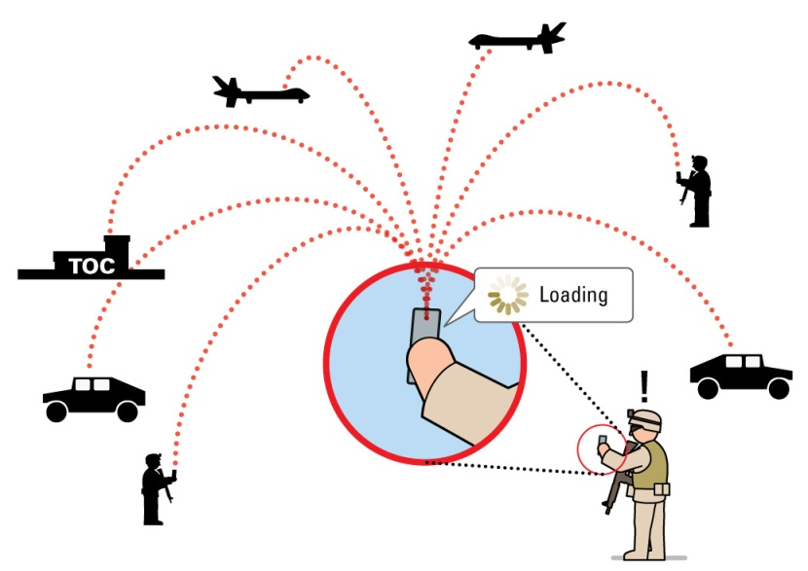
IMMoRTALS Goals and Motivation
Tactical Situation Awareness (SA) is a key part of modern warfare, law enforcement, humanitarian missions, etc.
SA is characterized by
Diverse and changing use cases and requirements
Many and changing operating environments
Long lifecycle in a fast evolving echo system
IMMoRTALS will develop, demonstrate and evaluate technology to make software evolve in this context
Notes:
Changing env:
Fully networked high bandwidth
No built-in infrastructure

Slide 6
Two Example scenarios
Introduce baseline application (android clients and a server) disseminating SA data first– may be a diagram
Mention that initially we are focusing on adapting to echo system changes that are prescribed as new mission requirements, and explain how the same work flow applies when such changes are sensed (diagram in poster?)
Then say that we are highlighting how IMMoRTALS work using variations of our CPs, highlight the differences between the CPs and what you are describing and why two (i.e., they illustrate different aspects/features– what are the differences?)
If pressed for time, we should consider 1 case only
Note: only 1 above needs a diagram, the rest are voice over– the diagram and some tweaking of the bullets below is all that is nee
To illustrate the vision, we present two ways in which the baseline application might evolve
New mission requirement: secure data-at-rest
New mission requirement: scale up number of users from 10 to 1000.

Slide 7
Example: Secure Data-at-Rest
Problem: devices are to be deployed in such a way that they might be lost. Any data stored on the device must be encrypted.
Desired outcome:
Identify parts of application that write to disk
Evaluate replacements if ‘encrypting’ versions of those application aspects exist, if not, attempt to combine an encryptor functionality with each functional component that writes to disk
Ensure that the extra resources needed to do encryption do not ‘break the budget’
Be ready to answer the question what shape or form the “encryptor” functionality are you starting with?
(what are they, where do they come from)
Also mention that encryption is an example of a class of transformations…

Slide 8
IMMoRTALs Data-at-rest
Program Analysis
Assume functional aspects of application are known.
Use Droidscope to find calls to File.write(). Work up the call-graph until we get to a functional aspect. Assume we find a functional component called TrackWriter.
Look for functional replacements for TrackWriter that have properties matching the mission requirements. If found, replace. If not, attempt to compose TrackWriter with other functionality.

Slide 9
IMMoRTALS Data-at-rest
Once replacement or composition finds suitable functionality, evaluate proposed solution against resource constraints (CPU, network bandwidth, etc)
If no resource constraints are violated, assemble application and test/validate.
Need to find a way to shorten this section. One idea is to show a code fragment and highlight statements, enclosing functions etc instead of text…
…and block diagrams instead of borders on text bullet…
… need to summarize the hard problems after the motivating examples
How to crawl up from lower level statements to higher level constructs
How to compose
How to collect the resource footprint of the composed construct, recourse when resource DSL fails?
How to build
Notes:
Possible solutions include:
A different implementation of TrackLogger that logs to the network instead
Composing baseline TrackLogger with an encryption DFU

Slide 10
Data-at-Rest: complicating factors
Resource consumption of encryption operations is input-size dependent.
Mission requirements might dictate 1MP image or 12 MP image.
Deployment hardware might affect input size or resource constraints in other ways (e.g. changed default image size, different amount of disk-storage)
Input size is “given” by a combination of deployment hardware and mission requirements.
IMMoRTALS will profile each DFU for each potential input size

Slide 11
Example: Scale number of users up
Problem: typical deployments of application involve < 20 clients, but a major event requires large numbers of clients.
Desired outcome:
Identify parts of the application that are affected by “number of clients”.
Identify constrained / oversubscribed resources
Evaluate functional components that might be added to relieve the constrained resources.

Slide 12
IMMoRTALS Scaling up: A-priori
Program Analysis
Assume functional aspects are known; architecture is known (i.e. PLA gives us knowledge of how platform aspects fit together).
Droidscope finds Socket.write() calls, and works up call-graph to functional aspect boundary to identify functional aspects using network.
PLA tells us which functional aspects are connected to the network, and how often each functional aspect is called (e.g. once per sec per client)

Slide 13
IMMoRTALS Scaling up
Evaluate resource consumption in new environment (more clients mean increased bandwidth needed for server and each client).
Identify functional options (e.g. compose ‘compression’ functionality with aspects that write to network).
Evaluate resource consumption of proposed solutions until a feasible option is found.

Slide 14
Scaling up scenarios
SA applications with a fixed report rate might vary in both report rate and number of clients, both of which have implications for bandwidth usage.
Image size affects both bandwidth consumption and CPU consumption.
Scenarios might change rate, number of clients, image size, available bandwidth

Slide 15
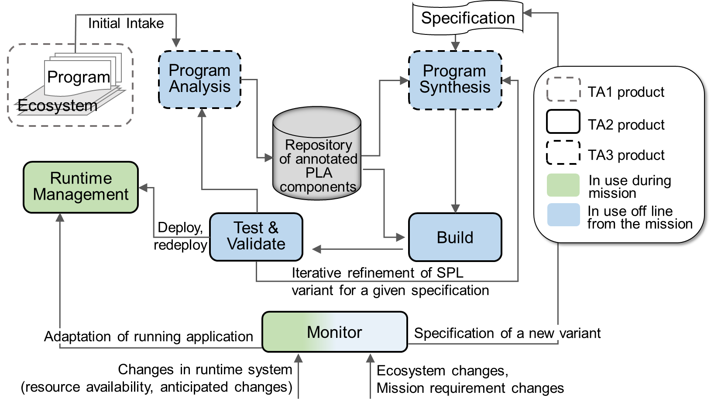
IMMoRTALS Solution Overview
Replace with the prescribed diagram?

Slide 16
Discrete Functional Units
DFUs are an IMMoRTALS concept that links together functional requirements (Features), code (Implementation) and extra functional specification (Resource dependency and usage)
IMMoRTALS representation of DFUs include
Functional Specifications
Resource consumption
Dependencies
DFU metadata can be discovered automatically (Muse / Droidscope / Mutation Testing), or through explicit programmer annotations

Slide 17
General Analysis Algorithm
Scenario: deployment hardware, mission req.
Match Mission Functionality
Look for compose options (functionality)
Sent comments on this separately
No
Yes
Fit Resource Constraints
Look for compose options (resources)
No
Yes
Look for compose options (transforms)
Builds
No
Yes
Runs
Re-profile DFUs or Manual Input (e.g. fix DFU metadata)
No
Yes
Deploy new variant

Slide 18
Matching Mission Functionality
Map mission requirements to properties of functional units
For each type of functionality:
Evaluate if any available DFU implementation for a given type of functionality satisfies all required properties
Build list of compliant DFUs
If we have at least one candidate DFU for each type of functionality, move on to resource constraint checking.

Slide 19
Resource Constraint Checking
Generate series of proposed solutions
E.g. if application has two functional types logger and locationProvider, and 2 DFUs that implement logger and 3 DFUs that implement locationProvider, we get 6 possible solutions that satisfy the mission req.
Evaluate the proposed full-application solution against available resources.
If any feasible solutions are found, move on to build.

Slide 20
Build and Test/Run
(TODO: some details about how program synthesis is going to work)
If build succeeds, run through validation tests
Deploy

Slide 21
Composing DFUs
We already have too much content…..the two motivating example and highlighting the issues will take time…
Functional: e.g. Explicit Mission requirement for data-at-rest encryption leads to implied requirement that the TrackLogger DFU must have “encrypted” property.
Need to compose a Crypto DFU with TrackLogger implementations to satisfy mission requirements.
Resource: compression of various forms trade off one resource for another
Transform: data-type transformations
e.g. (double lat, double lon) -> coordinate structure

Slide 22
Composing DFUs Challenges
Invertible?
Encryption and some kinds of compression need to be inverted (e.g. if you encrypt on the ‘write’ of some data, you need to decrypt on the ‘read’ of that same data).
Our application model will tell the DAS that two points in the application are linked, but challenges remain.
Ordering
The end result of encrypt(compress(byte[])) is very different from compress(encrypt(byte[])), which affects resource consumption.

Slide 23
Discovery via Mutation: Overview
Relying exclusively on annotations/DFU-based approach limits ability to discover non-critical resource uses in legacy or other non-annotated code
Solution: use the test suite to automatically identify non-critical functionality, map removal units to reclaimable resources
Mutate program P to program P’ that also passes test suite T
P’ has less code, but still passes all tests
Static and dynamic analysis used to split P-P’ into units and map those units to reclaimable resources
P
JavaReducer: Mutation + Delta Debugger
P’
T
T
Dynamic Analysis Traces: D
Dynamic Analysis Traces: D’
Static Analysis Result: S
Static Analysis Result: S’
Diff S-S’ D-D’
Resource Uses

Slide 24
Discovery via Mutation: Producing P’
Hierarchical delta debugging begins from bottom-up to remove code
Much larger removal units than traditional mutation testing
Looking for mutants that cannot be detected by test suite
Start removal at leaves of AST, move up
Resource uses: R1, R2, R3, R4, R5
Example:
Remove calls to system logger first
Remove initialization of system logger once all calls are gone
Result: P’ has less writes to SSD, lower memory usage (logging cache gone)
red code is removable
Resource uses: R1, R2, R4’, R5’ (R3 gone, R4/5 lower)

Slide 25
PlaceHolder: Outline for Syr/UCR
UC: Talk about how to fill in the Resource Consumption and Dependencies metadata for each DFU.
Start with “tester application” that allows maximum isolation of DFU
Talk about API mapping of system calls->resources (e.g. android.hardware.Camera.takePicture() -> camera dependency)

Slide 26
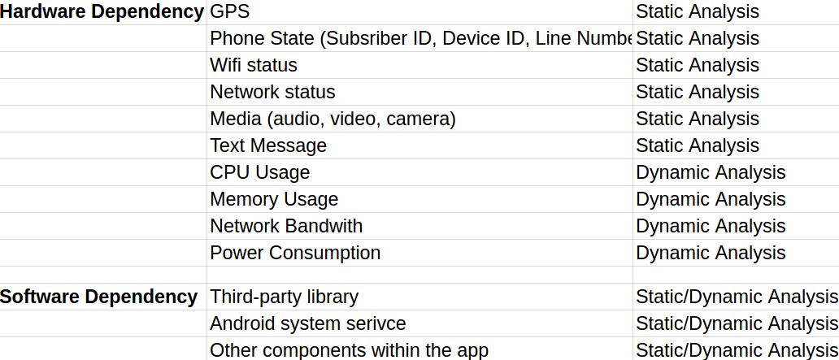
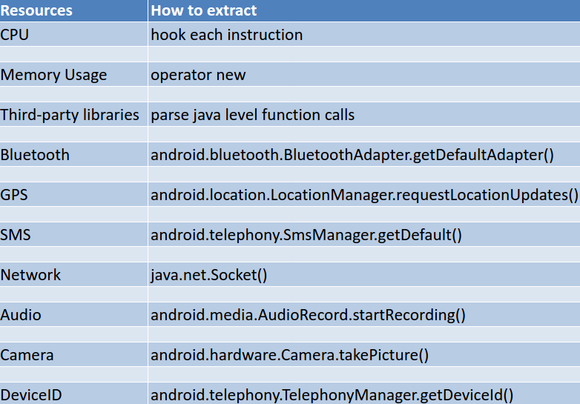
Resource Usage Analysis
We leverage program analysis to collect resource usage information.
Hardware Dependency: check if the application relies on certain hardware to function properly and try to quantify some resource usages
Software Dependency: dynamic analysis is needed to resolve some information such as INTENT

Slide 27
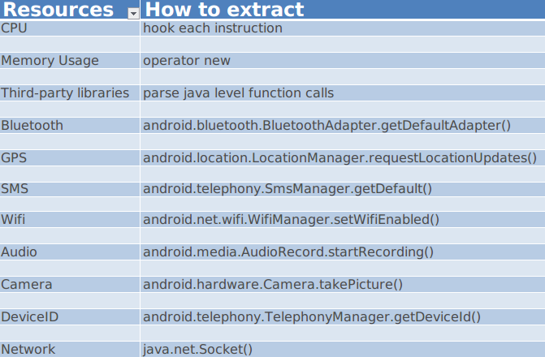
Resource Usage Analysis
Static analysis
Identify Important APIs as indicators of resource and then infer the usage
Dynamic analysis
Run the application and pinpoint the hooking points for information extraction

Slide 28
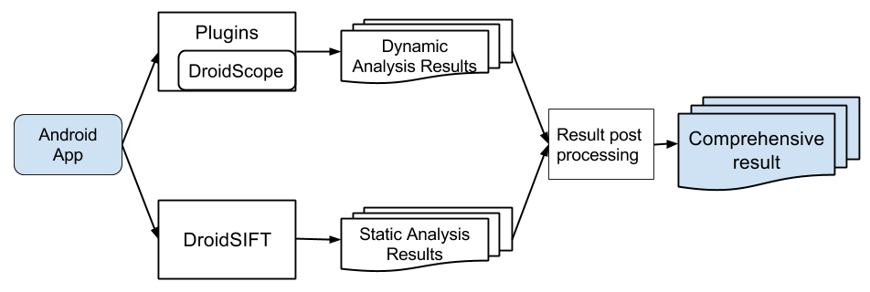
Resource Usage Analysis
Whole system consists of two major components
DroidSIFT: perform static analysis including call-graph analylsis and data dependency analysis
DroidScope: develop plugins on top of the emulation tool to collect resource usage information

Slide 29
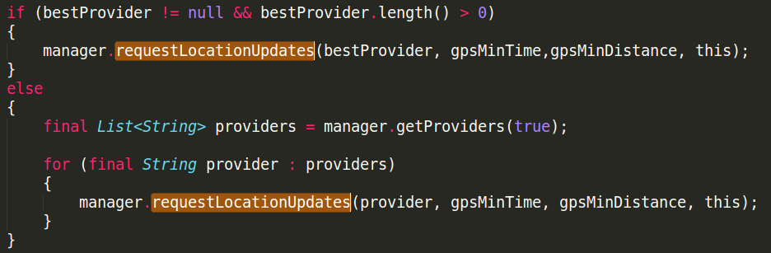
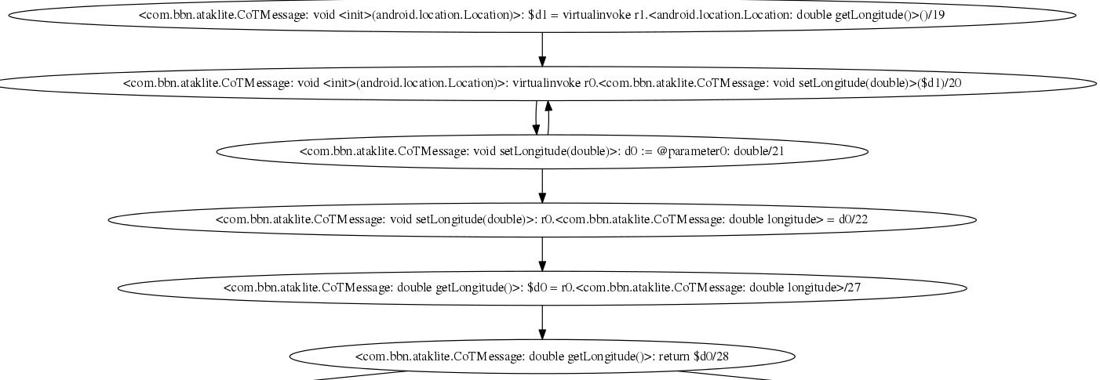
Resource Usage Analysis
Statically identify certain APIs as indicators of resource usage.
Perform data flow analysis to keep track of the data usage.

Slide 30
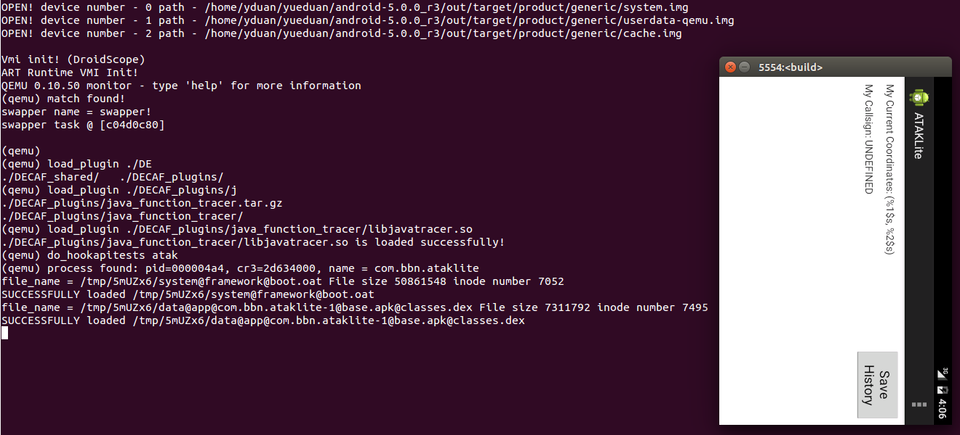
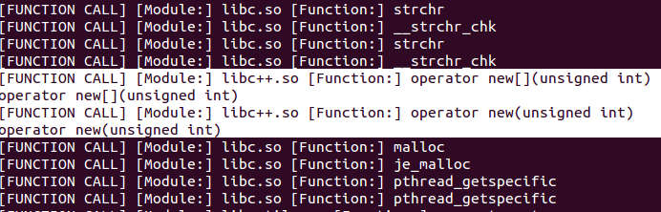
Resource Usage Analysis
Dynamically run the application in Droidscope which is based on Qemu.
Identify various of important hooking points and extract useful information.

Slide 31
PlaceHolder: Outline for Securboration
Discuss functional ontology, and use of properties and how they map to mission requirements
Discuss how programmer-provided annotations can stand in for data we expect to get from Muse (e.g. details of functional aspects)
Representation of PLA (e.g. control points)
Contrast of “data” about DFUs (e.g. resource dependency on USB) vs. “rules” (e.g. any DFU at this control point will be called NClient times per second.

Slide 32
Ontology
We model our problem space using a set of linked ontologies
ControlPoints are code regions where functionality equivalent components can be injected
Functional spec is conveyed by adding reusable properties to a core functional abstraction
Contrast with the strategy of explicitly enumerating all possible functionalities
E.g., a lossy compression algorithm for images:
compress : { lossy ^ applicableToDataType(Image) }
Core functionality abstraction
Simple property
Complex property
Property variable

Slide 33
Annotations
Annotations are one mechanism for conveying and storing knowledge about code
Programmer (provides high-level intent)
Static analysis (data flows, design patterns)
Dynamic analysis (resource use, live code behavior)
MUSE (extension of above)
We auto generate annotation-concept bindings that can later be parsed into semantic models
/**
* @param an array of bytes compressed with multi-pass LZMA (LZMA2)
* @return the decompressed data
*/
public @BinaryData byte[] decompress(
@BinaryData
@Compressed(compressionAlgorithm=LZMA2.class)
byte[] data
){

Slide 34
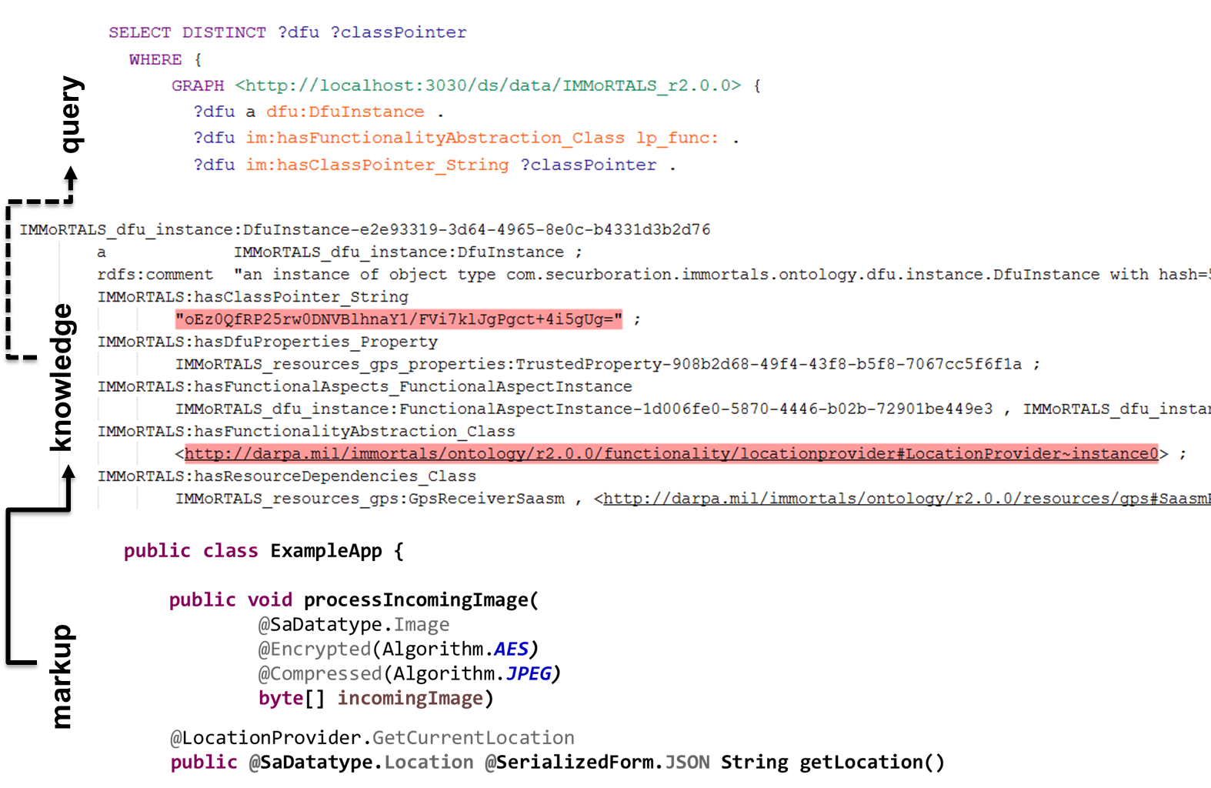
Use case

Slide 35

Environment / Mission Overview
Dynamic inputs (ecosystem model)
Environment
Mission Req
X …
X …
X ...
Static inputs
Resource DSL
Discovery
Analysis
Constructed System
Feature Model
App Model
f₁ * f₂
(g+h)
x
Permanent Store
Partial Annotations
DFU Types
r₁ {...}
r₂ {...}
@dfu
...
@dfu
r₁ {...}
r₂ {...}
@dfu
...
@dfu
r₁ {...}
r₂ {...}
@dfu
...
@dfu
The environment and mission motivate the design of the constructed system
Notes:
New mission requirement:
Secure the data-at-rest
Scale up number of users from 10^1 to 10^3
Identify a mapping between mission goals and technology and procedure.
Increase the number of mobile devices.

Slide 36

Modeling the Ecosystem
What is the ecosystem?
Why is the ecosystem important?
What have we done to model the ecosystem?
What next?
Adaptive demands originate from the ecosystem
Notes:
Modelling the ecosystem
What is the ecosystem?
The ecosystem consists of the environment and the mission goals and objectives.
Why is the ecosystem important?
The ecosystem is symmetric to the constructed system.
The ecosystem issues a set of challenges to which the constructed system responds.
We generate a set of specifications from the ecosystem models.
What have we done to model the ecosystem?
What next?
These two points are covered in the next slide.

Slide 37
Modeling the Ecosystem
What is the ecosystem?
Why is the ecosystem important?
What have we done to model the ecosystem?
What next?
Dynamic inputs (ecosystem model)
Environment
Mission Req
X …
X …
X ...
The ecosystem is everything that impinges upon the constructed system.
Notes:
Modelling the ecosystem
What is the ecosystem?
The ecosystem consists of the environment and the mission goals and objectives.
Why is the ecosystem important?
The ecosystem is symmetric to the constructed system.
The ecosystem issues a set of challenges to which the constructed system responds.
We generate a set of specifications from the ecosystem models.
What have we done to model the ecosystem?
What next?
These two points are covered in the next slide.

Slide 38
Modeling the Ecosystem
What is the ecosystem?
Why is the ecosystem important?
What have we done to model the ecosystem?
What next?
Dynamic inputs (ecosystem model)
Environment
Mission Req
X …
X …
X ...
Static inputs
Resource DSL
Discovery
Analysis
Feature Model
App Model
f₁ * f₂
(g+h)
x
Constructed System
Partial Annotations
Permanent Store
DFU Types
r₁ {...}
r₂ {...}
@dfu
...
@dfu
r₁ {...}
r₂ {...}
@dfu
...
@dfu
r₁ {...}
r₂ {...}
@dfu
...
@dfu
The ecosystem (and applications) prescribes and specifies the constructed system.
Notes:
Modelling the ecosystem
What is the ecosystem?
The ecosystem consists of the environment and the mission goals and objectives.
Why is the ecosystem important?
The ecosystem is symmetric to the constructed system.
The ecosystem issues a set of challenges to which the constructed system responds.
We generate a set of specifications from the ecosystem models.
What have we done to model the ecosystem?
What next?
These two points are covered in the next slide.

Slide 39
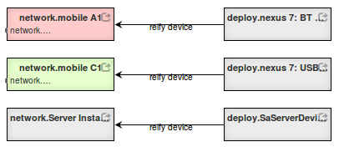
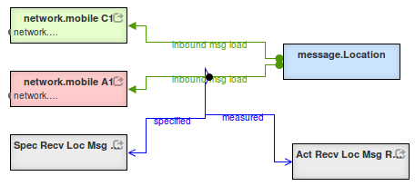
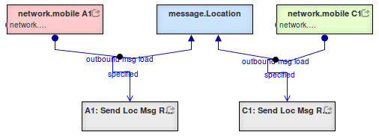
Modeling the Ecosystem
What is the ecosystem?
Why is the ecosystem important?
What have we done to model the ecosystem?
What next?
Mission model
Where do messages originate?
To whom are they directed?
Build a mega-model including cross-cuts.
Notes:
Modelling the ecosystem
What is the ecosystem?
The ecosystem consists of the environment and the mission goals and objectives.
Why is the ecosystem important?
The ecosystem is symmetric to the constructed system.
The ecosystem issues a set of challenges to which the constructed system responds.
We generate a set of specifications from the ecosystem models.
What have we done to model the ecosystem?
What next?
These two points are covered in the next slide.

Slide 40
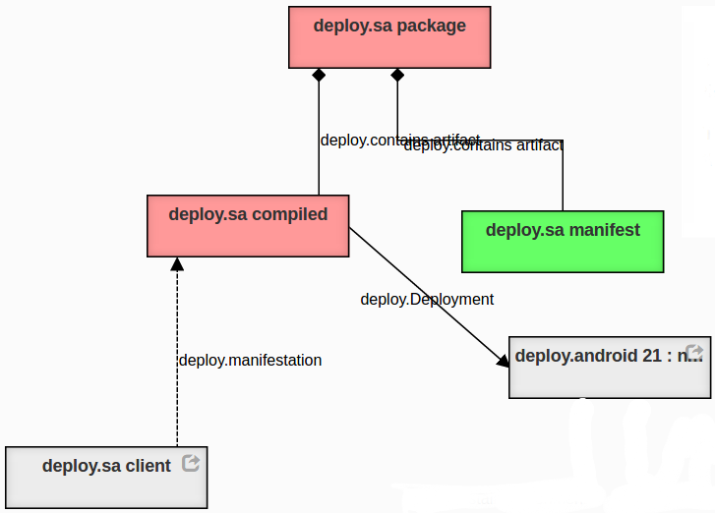
Modeling the Ecosystem
What is the ecosystem?
Why is the ecosystem important?
What have we done to model the ecosystem?
What next?
Component construction model
How are DFU’s composited to form components?
The components are assembled.
Notes:
Modelling the ecosystem
What is the ecosystem?
The ecosystem consists of the environment and the mission goals and objectives.
Why is the ecosystem important?
The ecosystem is symmetric to the constructed system.
The ecosystem issues a set of challenges to which the constructed system responds.
We generate a set of specifications from the ecosystem models.
What have we done to model the ecosystem?
What next?
These two points are covered in the next slide.

Slide 41
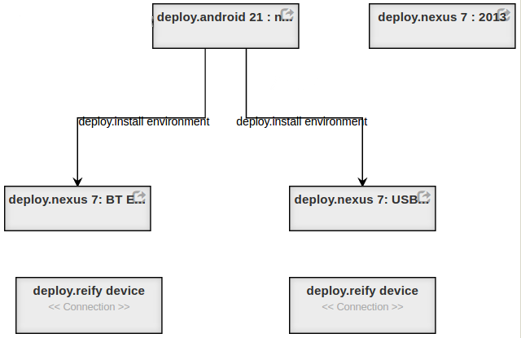
Modeling the Ecosystem
What is the ecosystem?
Why is the ecosystem important?
What have we done to model the ecosystem?
What next?
Package model
How are components are composited to form executables?
The components are combined to form packages for specific purposes.
Notes:
Modelling the ecosystem
What is the ecosystem?
The ecosystem consists of the environment and the mission goals and objectives.
Why is the ecosystem important?
The ecosystem is symmetric to the constructed system.
The ecosystem issues a set of challenges to which the constructed system responds.
We generate a set of specifications from the ecosystem models.
What have we done to model the ecosystem?
What next?
These two points are covered in the next slide.

Slide 42
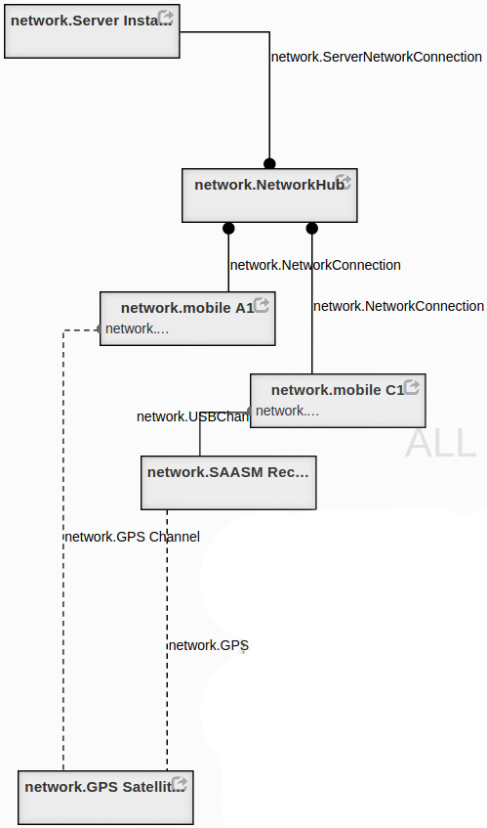
Modeling the Ecosystem
What is the ecosystem?
Why is the ecosystem important?
What have we done to model the ecosystem?
What next?
Network topology model
Along what paths are devices able to communicate?
The network names hardware and their locations.
Notes:
What have we done to model the ecosystem?
Discuss aspects of the “deployment-model” (ecosystem-model).
Discuss GME tool for modeling and generation of validation and construction artifacts.

Slide 43
Modeling the Ecosystem
What is the ecosystem?
Why is the ecosystem important?
What have we done to model the ecosystem?
What next?
Generate script to deploy software to specific devices
Formal methods
Type systems (DSL)
Construction following specification
Property-based testing and surveying
Run time observation and measurement
Construct logger configuration to record and monitor key metrics.
The ecosystem mega-model specifies behavior for the constructed system.
Notes:
What next?
We generate a set of specifications from the ecosystem models.
These specifications can be used to verify the constructed system:
By formal methods
By type-systems
By correct construction (in-progress)
By property-based testing in simulated environments
By observation and measurement of fielded system
Property-based:
https://fsharpforfunandprofit.com/posts/property-based-testing-2/
https://www.youtube.com/watch?v=zi0rHwfiX1Q

Slide 44
Modeling the Ecosystem
What is the ecosystem?
Why is the ecosystem important?
What have we done to model the ecosystem?
What next?
Graph Based Macro Templates for Implementation
Compose software elements by binding templates.
Archive templates as tree fragments.
Visualizations
Type-system examination and editing.
Impact analysis examination.
Initiate mediation activities.
Specification Based Verification
Use formally validated components when available.
Type-based checking.
Property based testing in simulated environments.
Analysis of Models by Graph Traversal
Source code contain more information than needed for analysis —models strip away the incidental complexity— .
Source code lacks information for many types of analysis —integrating specification through annotations can help—
Conveniently retain inter-model relationships —Identify conflicts by examining cross cuts—.
Visualization and Perceptive Models
Graph based visualization —focus in context— .
The ecosystem mega-model specifies behavior for the constructed system.
Notes:
Some other candidates for future effort.
The braided blivet is an icon that expresses the fundamental problem.

Slide 45
IMMoRTALS (Tactical SA) Platform
IMMoRTALS code base, build and test environment
Error report, deploy/update SW
IMMoRTALS Management Network
Host
Ecosystem
SA producer & consumer
Brokering and Storage
IMMoRTALS back end
Operational Network
Server Host
Android
Ecosystem
Ecosystem
Deployed/running platform application
Android Clients
Linux/Java Server
Backend
Change detection tools
Runtime management tools
Program synthesis tools
Build tools
Validation tools
Program analysis tools
Repo
y

